Slide 1
Team-Learning Their Way to Unity: It’s All About Personal Information
This session explores one way to increase student team performance by focusing on providing opportunities to increase interpersonal understanding and social learning among team members, which has been shown to have positive effects on team performance in organizations. We will briefly review the process model of team learning and will describe how as instructors, we can positively influence the group process and ultimately increase team performance, with the added positive outcomes of cohesiveness and trust.
Julie “J.P.” Palmer, Ph.D, Webster University

Slide 2
Agenda
Replication of “setting the stage”/class climate---class culture and norms
Brief overview of “learning teams” (Senge, 1990)
Opportunities
Exercise
Debriefing

Slide 3
Who is JP? What I share with the class on day 1
Your life is your context, and context can make all the difference……..
Paradigms don’t have to limit us……. (i.e., break those “rules” that are not rules but rather assumptions……..
Sharing is key……
I hope to make a difference……..
I don’t know everything……..but I will find out for you
I trust you, and I believe you…….
Relevancy is as important as knowledge (in my opinion)……

Slide 4
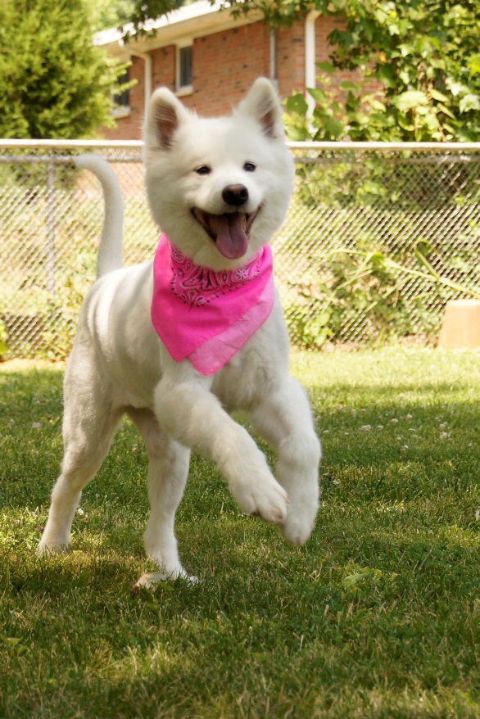
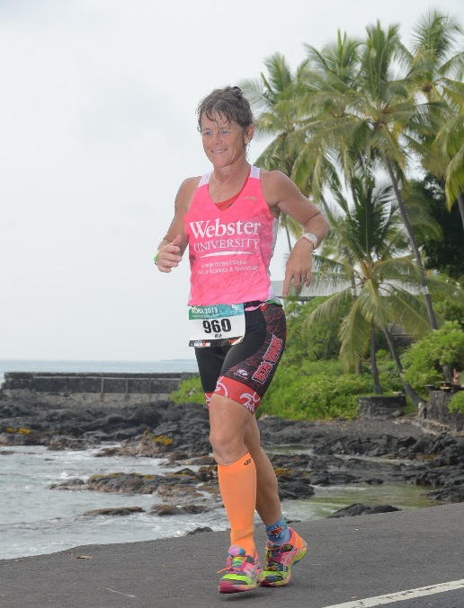
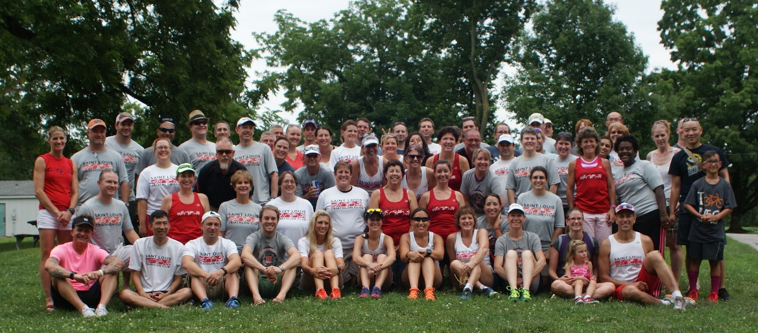
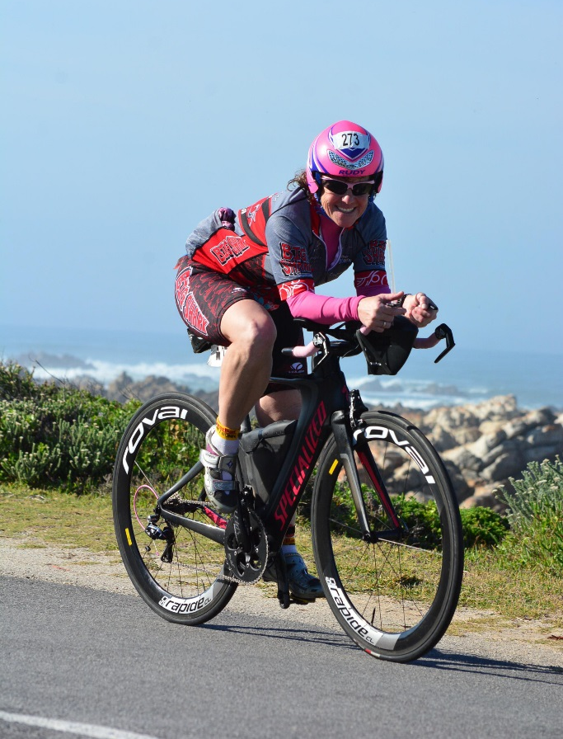
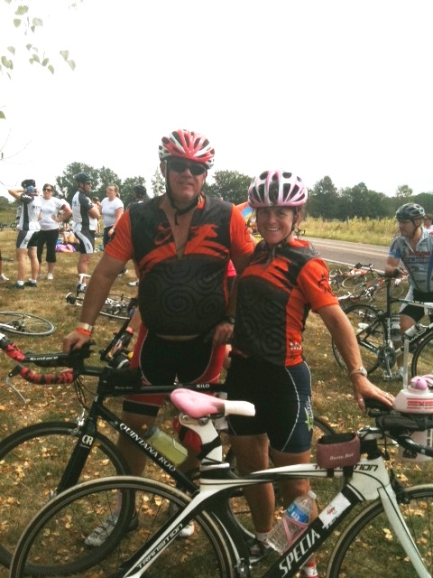

Slide 5
Team Learning/Learning Teams
Druskat and Kayes’ (2000) definition of team learning: team-level process of member behaviors that include reflection, knowledge sharing, experimentation, feedback, error correction, helping, and continuous improvement
Kayes and Kayes (2007) process model of team learning: how student inputs (roles, goals, trust, interpersonal understanding, goals, and confidence) coupled with learning behaviors (coordinating, adapting, and continuous improvement) affects team performance
Social learning occurs when team members learn personal information about team members such as character, personal life, habits, and values (Huckman et al., 2009) and research suggests that social learning leads to quality team outcomes (increased performance measures)

Slide 6
opportunities
Team formation: introducing other members after ‘interviews” (stolen from OBTC 2007, Bob Herring)
Personal Change Project Updates (refined after many OBTC presentations
“My struggles” exercise sharing (stolen from OBTC 2011)
Reflection papers---how to give feedback (stolen from OBTC 2013)
The love session last year with John Stark and Rita Shea-Van Fossen

Slide 7
Teams within class
Social identity theory also suggests that individuals prefer others who are similar to themselves (both dimensions of PO fit are relevant here)
Social identification develops when individuals believe they are representatives of a social group (Tajfel & Turner, 1986)
By extension, we suggest using the classroom as the “in-group” to which we try and create an environment where students have knowledge at multiple levels regarding their peers

Slide 8
“exercise”
Strategy class at Mizzou……Jay Dix Race
Personal change project “Updates”
In other classes………could add a “Personal Challenge” that you do alongside your students and share successes/struggles/strategies

